Slide 1
Chapter 1 What is Sport and Why Do We Study It?
C H A P T E R
29
Stakeholder Expectations

Slide 2
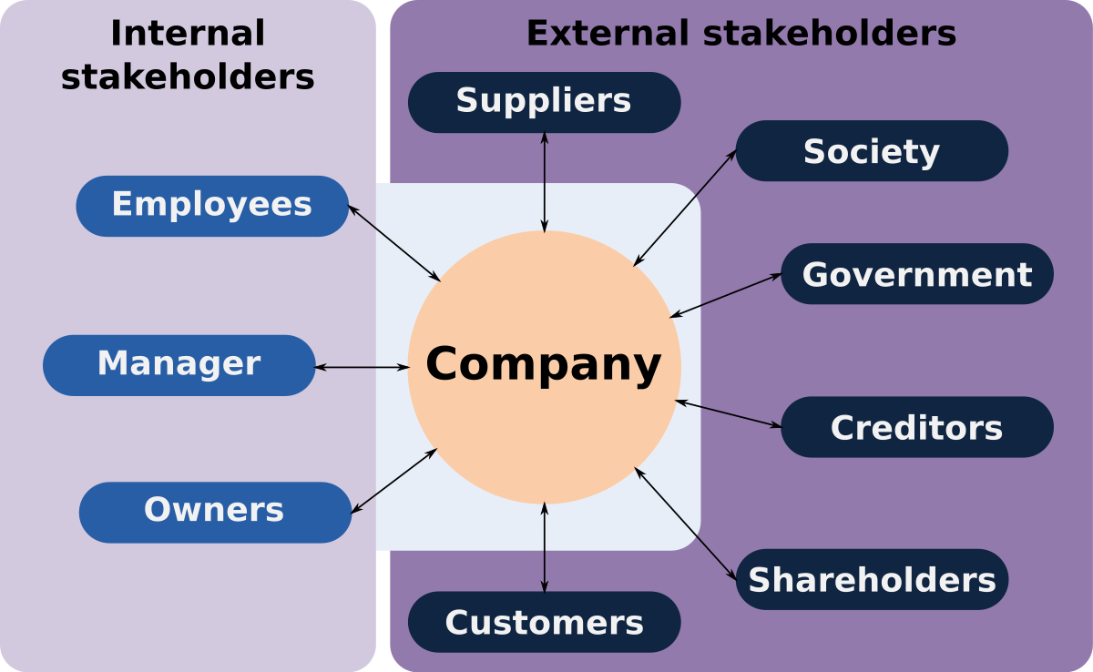
Range of Stakeholders
ISO Guide 73 definition = a person or group concerned with, affected by, or perceiving themselves to be affected by an organization

Slide 3
Range of Stakeholders
Stakeholders may have contradictory expectation of the organization
For example: employees will want the highest pay possible while the owner wants the business to be as profitable as possible

Slide 4
Stakeholder Dialogue
The level and nature of dialogue with stakeholders will depend on the particular interests of the stakeholder in the operations of the organization
  For example, if I wanted to invest $100,000 in your business, what kind of information would I want compared to your customers?
To obtain the fullest picture of the risks facing an organization, analysis of stakeholders and their expectation is necessary.

Slide 5
Stakeholder Dialogue
Data for shareholders
General A clear statement of strategy and vision Corporate profile and principal markets
Financial data Annual report and financial statements Archived financial information for the past three years
Corporate governance and CSR Information related to compliance with Combined Code Information on the company CSR policies
Shareholder information Shareholder analysis by size and constituent Information on directors’ share dealings
Relevant news Access to all news releases and presentations Developments that might affect the share value

Slide 6
Attendance/Participation
Who are the stakeholders in your business and what are their expectations?
For example, a coffee shop…
Stakeholder | Expectations
1. Customers | Good coffee
2. Staff | Respect
3. Financiers | Good reviews
4. Suppliers | Consistency
5. Regulators | Pay taxes
6. Community | Put $ back into the business

